Slide 1
SPPAM:
Signature
Pattern
Prediction and
Access-
Map Prefetcher
Maccoy Merrell, Lei Wang, Stavros Kalafatis, Paul V. Gratz

Slide 2
Outline
Introduction
Background and Motivation
Design
Evaluation
Conclusion
AMPM
SPP
Single Core
Multi Core

Slide 3
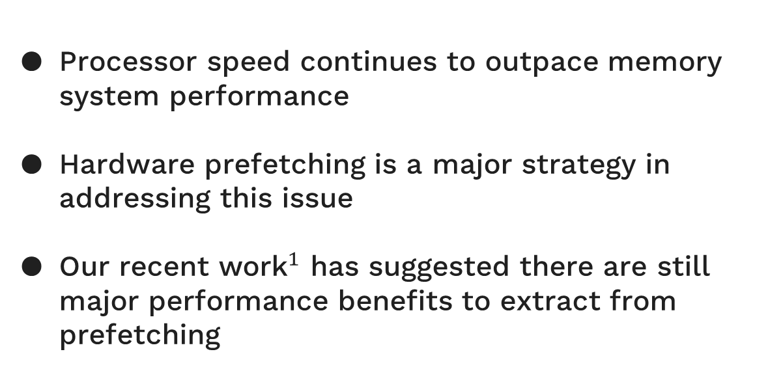
Introduction
Processor speed continues to outpace memory system performance
Hardware prefetching is a major strategy in addressing this issue
Our recent ${\text{work}}^{1}$ has suggested there are still major performance benefits to extract from prefetching
[1] Lei Wang, Chia-Hang Lee, Maccoy Merrell, Gino Chacon, Daniel A. Jiménez, and Paul V. Gratz. 2025. R-Max: A Method for
Approximating the Benefit of Ideal Prefetching and Replacement Policy. IEEE Computer Architecture Letters 24, 2(2025),
293–296. doi:10.1109/LCA.2025.3611316
Notes:
Processors continue to outpace memory on conventional computers. Of course, caching and other methods attempt to solve this problem by storing reused data to reduce the overall references to main memory that need to be made.
Prefetching builds upon this concept and tries to also avoid issuing as many of these references on-demand as possible, bringing them into the cache before their first reference.
Our recent work strongly suggests that many workloads do not see the full benefits of prefetching, and that even with realistic bandwidth constraints an ideal prefetcher would be able to increase performance by more than 60% over the current state-of-the-art.

Slide 4
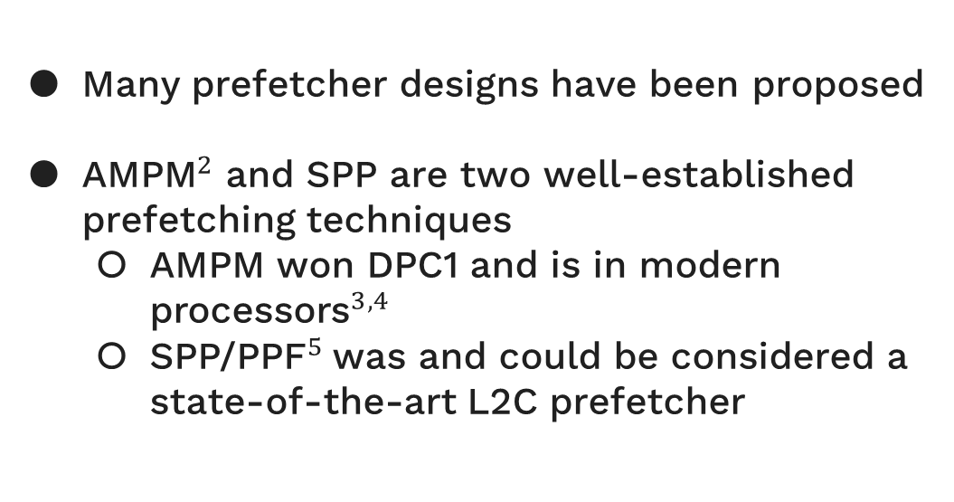
Introduction
Many prefetcher designs have been proposed
${\text{AMPM}}^{2}$ and SPP are two well-established prefetching techniques
AMPM won DPC1 and is in modern ${\text{processors}}^{3,4}$
${\text{SPP}\text{/}\text{PPF}}^{5}$was and could be considered a state-of-the-art L2C prefetcher
[2] Yasuo Ishii, Mary Inaba, and Kei Hiraki. 2011. Access map pattern matching for high performance data cache prefetch. Journal of Instruction-
Level Parallelism 13,2011 (2011), 1–24.
[3] Magnus Bruce. 2023. Arm Neoverse V2 platform: Leadership Performance and Power Efficiency for Next Generation Cloud Computing, ML and
HPC Workloads.IEEE.
[4] Stephan G Meier, Gerard R Williams, Hari S Kannan, and Pavlos Konas. 2015.Access map-pattern match based prefetch unit for a processor.
[5] Jinchun Kim, Seth H. Pugsley, Paul V. Gratz, A. L. Narasimha Reddy, Chris Wilk-erson, and Zeshan Chishti. 2016. Path confidence based
lookahead prefetching. InThe 49th Annual IEEE/ACM International Symposium on Microarchitecture (Taipei,Taiwan) (MICRO-49). IEEE Press,
Taipei, Taiwan, Article 60, 12 pages.
Notes:
There is no shortage of different prefetcher designs. AMPM and SPP are two well-established technique. Both have seen implementations in real processors, with AMPM being associated with both the L1D and L2C, and SPP/PPF being a pure L2C prefetcher.

Slide 5
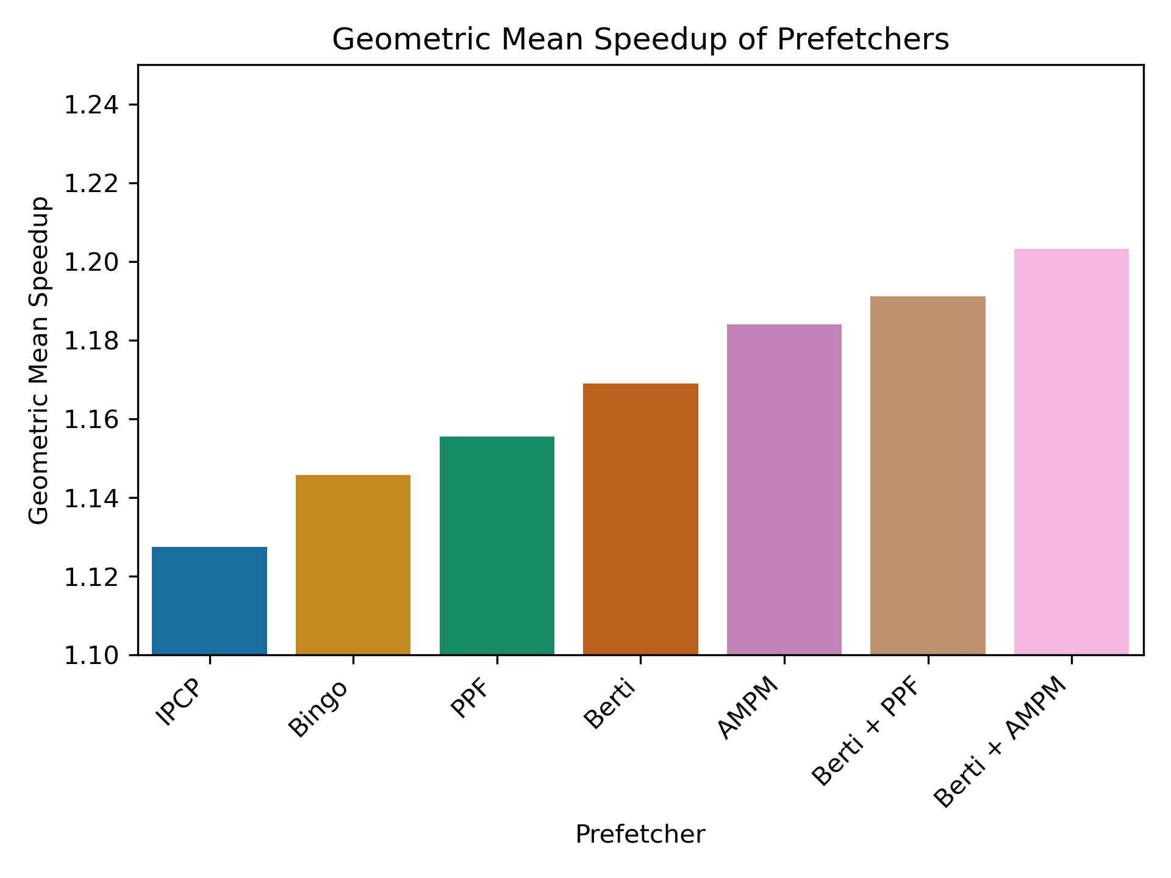
Introduction
AMPM relies on hard-coded pattern detection which fails to adapt to complex workloads but provides consistent behavior
SPP/PPF is susceptible to pattern noise caused by the OoO core but can prefetch complex access patterns
SPPAM seeks to solve both problems, overcoming the limitations of these previous designs
Notes:
These techniques each have flaws. AMPM is not a dynamic prefetcher – it uses a static set of patterns which is helpful for it’s consistent behavior but means it may fail to exploit readily-apparent patterns. SPP (PPF) is susceptible to pattern noise which means that when reordering within the core becomes high, SPP can have trouble learning. Both prefetchers perform well – they perform within a percent of each other when paired with Berti. On the right, the speedups of some of the previous DPC champions compared with these. This was calculated on our own internal set of traces rather than the DPC4 trace set. This included SPEC2006, SPEC2017, GAPs, and XSBench as the target workloads.

Slide 6
Background - AMPM
For regions (typically pages) demand block accesses are recorded in bitmaps
When this access map shows a recognized pattern, prefetches are generated
AMPM’s strategy is self-filtering, as previously accessed demand blocks or prefetched blocks cannot be reprefetched
Notes:
AMPM divides the address space into regions, typically pages though for some variants like virtually-addressed AMPM these regions could be sized arbitrarily large. Within these regions, we can use bitmaps to indicates which blocks have been accessed and which have been prefetched. If AMPM recognizes a pattern emerging within the access map, it can prefetch based on that pattern. The prefetch map is useful, since it prevents prefetched blocks from being reissued. This is a good filtering technique, and one we utilize heavily for our prefetcher.

Slide 7
Background - AMPM
Region 0xaa
Region
0xbb
Region
0xcc
Region: 0xaa
Offset: 0x3
Set bitmap
Notes:
AMPM can be visualized as having this monolithic region table structure which stores all our recently used regions in a set-associative fashion.
For any access, AMPM identifies the region and will look up it’s entry in the table and mark the offset in that region as being used.
So here, address hex 0xaa003 will go to region 0xaa and mark the offset of 0x3.

Slide 8
Background - AMPM
Region 0xaa
Region
0xbb
Region
0xcc
Region: 0xbb
Offset: 0x3
Pattern match!
Set bitmap
Prefetch 0xbb004
Notes:
Each time AMPM is setting a bit here in the access map, it is also checking for a pattern to emerge. The variant that ships with ChampSim actually has only one pattern that it recognizes – 111. In this case when AMPM recognizes the pattern, it can choose which blocks it wants to prefetch.
You can think of this as taking in a history of 111 and then predicted the next N blocks, whether that would be a 2-bit prediction of 10 or a three bit prediction of 101, etc… AMPM is going to only prefetch those lines not previously prefetched, so these predicted patterns will be marked and not re-fetched within the prefetch map for the region. This independent tracking of the two prevents a runaway effect, where AMPM’s prefetches trigger patterns which trigger prefetches which trigger patterns and so on.

Slide 9
Background - SPP
SPP is a similar prefetcher to AMPM
Instead of an access map, we have a delta history (signature) for each region
This delta signature is a more descriptive, signed sequence of deltas
SPP adaptively identifies patterns, and forms an internal graph for determining prefetch paths
PPM / Markov chains
A recent-access filter functions similarly to AMPM’s prefetch map
Notes:
SPP – The signature path prefetcher – Is another prefetcher – far more recent and it came out of our research group a while back. When all the technical talk is put aside, SPP is actually very similar to AMPM and could be thought of as another flavor of the same technique. Instead of access maps, SPP stores only a short delta history (signature) for each region. The delta signature is short, but descriptive as it tells the last 3 signed jumps (deltas) the region took within it’s boundaries. This is far more space-efficient than an access map, assuming that we are dealing with a relatively short signature.
The main difference besides the difference in region history tracking is the patterns themselves. AMPM uses a pre-encoded catalogue of patterns, while SPP learns patterns from repeated signatures.
SPP will tally the occurrences of signatures, say a signature of [1,1,1] which leads to a signature of [1,1,2]. This indicates that a delta of 2 should be predicted for the signature [1,1,1]. The pattern table will encode this information, and allow SPP to make the best prediction choice for the workload.
Filtering through SPP is done block-wise instead of by access map, and this filter prevents recently prefetched blocks from being reprefetched.

Slide 10
Background - SPP
Region 0xaa
Region
0xbb
Region
0xcc
Region: 0xbb
Offset: 0x3
Last Offset
Last Offset
Last Offset
3
2
1
Signature
Signature
Signature
1
1
1
3
-2
1
-1
-1
-1
3
To Pattern Table
3
-2
1
1
Signature is updated
Notes:
An access is coming into region 0xbb with an offset of 0x3. Based on the last offset into the page, we can determine this is a delta of 1 over the previous offset. This can then be used to update the signature.
This updated signature (now 4 entries long) can be sent to the pattern table for two different things to be done. Only the most-recent 3 accesses of the region are kept in state.

Slide 11
Background - SPP
Signature
[3, -2, 1]
Signature
[1, 1, 1]
Signature
[-2, 1, 1]
Delta
Conf
Delta
Conf
Delta
Conf
3
-2
1
1
1
75
1
99
1
80
Signature
Delta
2
43
-1
7
-2
20
3
29
2
0
2
5
76
Confidence is increased
Notes:
SPP can use the old signature with the new delta to update the confidence of this delta prediction for the signature in it’s pattern table. Here, we update the confidence of delta 1 for a signature of [3, -2, 1] to 76 from 75.

Slide 12
Background - SPP
Signature
[3, -2, 1]
Signature
[1, 1, 1]
Signature
[-2, 1, 1]
Delta
Conf
Delta
Conf
Delta
Conf
3
-2
1
1
1
76
1
99
1
80
Signature
2
43
-1
7
-2
20
3
29
2
0
2
5
Prefetch +1
The new signature is used to predict the next delta
Notes:
SPP can then use the new signature to make a prediction. Here it indexes entry [-2,1,1] and finds the most-common following delta is 1, so it will predict a delta of 1 from this most recent access to be prefetched next.

Slide 13
Background - SPP
Prefetch +1
Signature
[3, -2, 1]
Signature
[1, 1, 1]
Signature
[-2, 1, 1]
Delta
Conf
Delta
Conf
Delta
Conf
3
-2
1
1
1
1
76
2
99
1
80
Lookahead Signature
2
43
-1
7
-2
20
3
29
2
0
2
5
Prefetch +2
The delta of a previous prediction can be used to generate additional deltas
Notes:
This delta prediction can be appended to the original signature to generate an additional delta. This functionality allows SPP to issue many prefetch requests from a single trigger, which is essential for maximizing prefetcher performance.
[1,1,1] predicts a delta of 2, so it will prefetch a +1 and +3 delta from its original position. These confidences you see within the table are also used beyond making replacement decisions. SPP will track a rolling-confidence as it continues down a lookahead path, so SPP will stop lookaheads down lower-confidence paths sooner.

Slide 14
Motivation - Weaknesses
AMPM cannot prefetch complex access patterns
SPP must learn patterns, and is sensitive to access reordering. A +1 stride may be represented as:
SPP has a short history and is systemically biased towards the most-common delta +1.
SPP’s pattern table is deceptively small
SPP may be able to learn after multiple repetitions
[1, 1, 1]
[2, -1, 2]
[1,2,-1]
…
Each signature predicts a delta
That delta is appended to the signature
SPP can only link a small number of nodes within its graph
Notes:
There are some key weaknesses that both prefetchers have. AMPM, of course, is going to be unable to learn access patterns unique to a workload. It is limited to what it has (at least in the base form of AMPM) so will not be able to prefetch complex access patterns.
SPP can learn these patterns, but is quite vulnerable to request re-ordering. As an example, a +1 stride where we go from block a to b to c and so on may be issued out of order from the core or reordered due to activity in the upper-level caches.
This means a, b, and c may arrive in-order, but they could also arrive b, a, c or c, a, b. These orderings have different deltas, so SPP is unnecessarily splitting hairs, which can increase learning time and cause interference for authentic patterns that display this behavior.
There is a final issue, which is that +1 strides are incredibly common across most workloads. Aliasing within the pattern table and just general likelihood are going to interfere with the pattern table and cause +1 strides to be the most-common. +1 strides lead to [1,1,1] signatures, and now we have all signatures which undergo lookahead converging to [1,1,1] which of course predicts 1 as the delta. This all-roads-lead-to-Rome behavior is undesirable.
Finally, SPP is essentially building a graph through it’s pattern table, but this graph is limited in the edges it can produce. A single signature predicts one delta, of lets say -4 to 3. This means there are only 7 edges each node can have in SPP’s system, and those are likely to conflict with others.

Slide 15
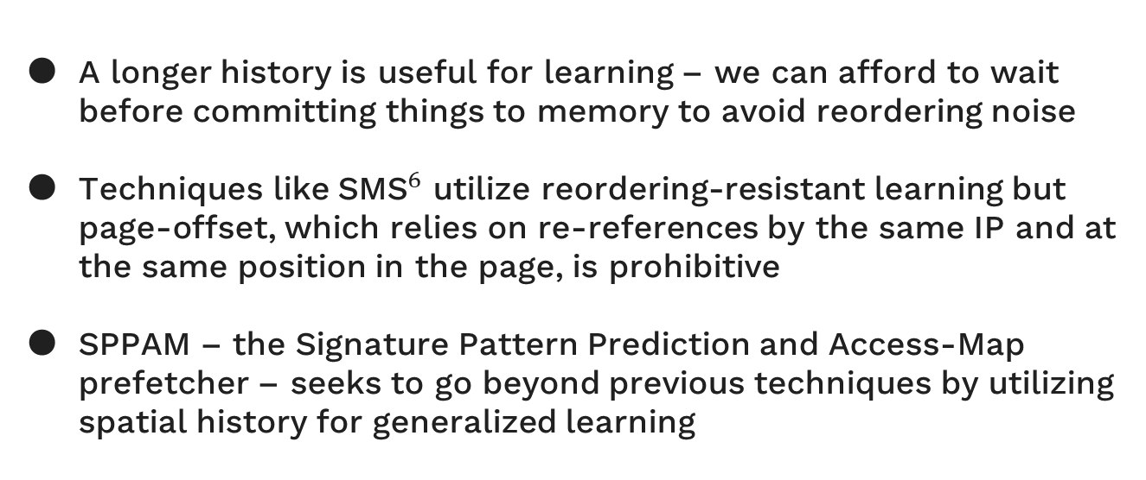
Motivation - SPPAM
A longer history is useful for learning – we can afford to wait before committing things to memory to avoid reordering noise
Techniques like ${\text{SMS}}^{6}$ utilize reordering-resistant learning but page-offset, which relies on re-references by the same IP and at the same position in the page, is prohibitive
SPPAM – the Signature Pattern Prediction and Access-Map prefetcher – seeks to go beyond previous techniques by utilizing spatial history for generalized learning
[6] S. Somogyi, T. F. Wenisch, A. Ailamaki, B. Falsafi, and A. Moshovos, ‘Spatial Memory Streaming’,
in 33rd International Symposium on Computer Architecture (ISCA’06), 2006, pp. 252–263.
Notes:
There are some clear improvements we can make. 1. AMPM could utilize SPP’s online-learning to build it’s patterns on the fly.
2. AMPM has access to a longer history – so by increasing the pattern length we can avoid this [1,1,1] convergence which SPP is suffering from.
This longer history is also in bitmap form , meaning the order of these requests is not impacting our ability to recognize patterns. These key improvements are exactly what SPPAM – The Signature Pattern Prediction and Access Map Prefetcher – is trying to make.

Slide 16
Design – Region Table
Region 0xaa
Region
0xbb
Region
0xcc
Region: 0xaa
Offset: 0x2
To Pattern Table
[1,0,1]
Notes:
For illustration purposes, I am going to be displaying a pattern length of 3, though we got the best performance of a pattern length of 6.
When a region is accessed at offset 0x2 in this case, we can take that access along with the previous 2 (spatially) to generate a pattern – the goal here is to predict which of the next pattern-length accesses will be used. So we get the bitmap of the previous 3 or 6 accesses, and we want to know
What the bitmap for the next 3 or 6 accesses is likely to be.

Slide 17
Design – Pattern Table
Pattern 000
Pattern 001
Pattern …
Pattern 101
Pattern …
Region: 0xaa
Offset: 0x2
Prediction
Conf
Prediction
Conf
Prediction
Conf
Prediction
Conf
Prediction
Conf
[1,0,1]
000
86
100
56
…
…
010
72
…
…
100
43
111
35
…
…
110
15
…
…
010
5
001
20
…
…
111
3
…
…
Prefetch 0xaa at 0x4
010 can be used to perform lookahead
Notes:
If we look up this pattern in our pattern table (which is direct-mapped, a pattern of 6 only requires 64 entries so this avoids aliasing disturbances as well as being small) we can make, we can choose the 3-bit prediction that is most commonly after this pattern. These are managed associatively, and in our implementation, we used 16 entries for each pattern.
We predict 010 will follow 101 – which is reasonable, which leads to offset 4 being prefetched from offset 2 from region aa

Slide 18
Design - Learning
SPPAM can utilize the access map as it’s history, so it can wait until all references are complete until committing it to memory
Heuristics are used to reinforce the learning of timely information, since old regions tend to converge to all 1s
Time since last access
Accumulated access counts
Notes:
Unlike SPP, we are managing multi-target predictions for a given pattern. This means that learning is not as simple.
We must wait until enough history is accumulated before learning, or we may accidentally exclude or include certain accesses.
SPPAM utilizes two heuristics to determine if a region is ready to learn from – “scrape”
Time since last access – so a counter that decreases each cycle and indicates whether this region has “died” and is ready to be learned from
Accumulated access counts – another down counter which manages how many recent accesses the region has had since it’s last scrape, and whether it can learn. The latter of these is far more reasonable and less power-hungry to implement, though we got the best performance from utilizing both together.
The goal of this once again is timeliness, we want to learn to prefetch things that will be used soon after, to reduce strain on the cache and bandwidth.

Slide 19
Design - Learning
Region 0xaa
!
Access Count:
Access Timer:
982
0
0
7
[101], [010]
[010], [101]
[010], [101]
[101], [010]
[010], [101]
[101], [010]
[101], [010]
To Pattern Table
Notes:
Here, we can see this process. The region ages out either by timer or access count. At this point, SPPAM will slowly go through this region and take 6-bit segments (for a pattern and prediction size of 3) and offload those to the pattern table, where it will increase the confidence of each identified pattern-prediction pair. Here, the access map is indicating a strong +2 stride, so these patterns are going to appear as [010, 101] or [101, 010] pairs.

Slide 20
Design - Learning
Pattern 000
Pattern …
Pattern 010
Pattern …
Pattern 101
[101], [010]
[010], [101]
[101], [010]
[010], [101]
[101], [010]
[010], [101]
[101], [010]
Prediction
Conf
Prediction
Conf
Prediction
Conf
Prediction
Conf
Prediction
Conf
000
86
…
…
101
98
…
…
011
49
100
43
…
…
111
50
…
…
000
20
010
5
…
…
100
10
…
…
Prediction
Conf
001
5
011
49
000
20
010
4
010
4
Notes:
Once these arrive at the pattern table, we increment confidences similarly to how SPP manages it’s deltas in it’s pattern table.
We evict the least-confidence pattern from entry 101 and replace it with 010, and this is given a confidence of 4 once we tally up all the pairs.

Slide 21
Design - Learning
Pattern 000
Pattern …
Pattern 010
Pattern …
Pattern 101
[101], [010]
[010], [101]
[101], [010]
[010], [101]
[101], [010]
[010], [101]
[101], [010]
Prediction
Conf
Prediction
Conf
Prediction
Conf
Prediction
Conf
Prediction
Conf
000
86
…
…
101
98
…
…
011
49
100
43
…
…
111
50
…
…
000
20
010
5
…
…
Prediction
100
Conf
10
…
…
010
4
101
51
51
111
25
25
100
5
5
Notes:
We then move on to entry 010, which we tabulate a total of 3 increments for. Once a confidence entry maxes out, we halve the values of the confidence of all other entries – a strategy used by SPP – to age those entries out. In this case, all this causes all confidences to reduce substantially and the final confidence of 101 to end at 51.

Slide 22
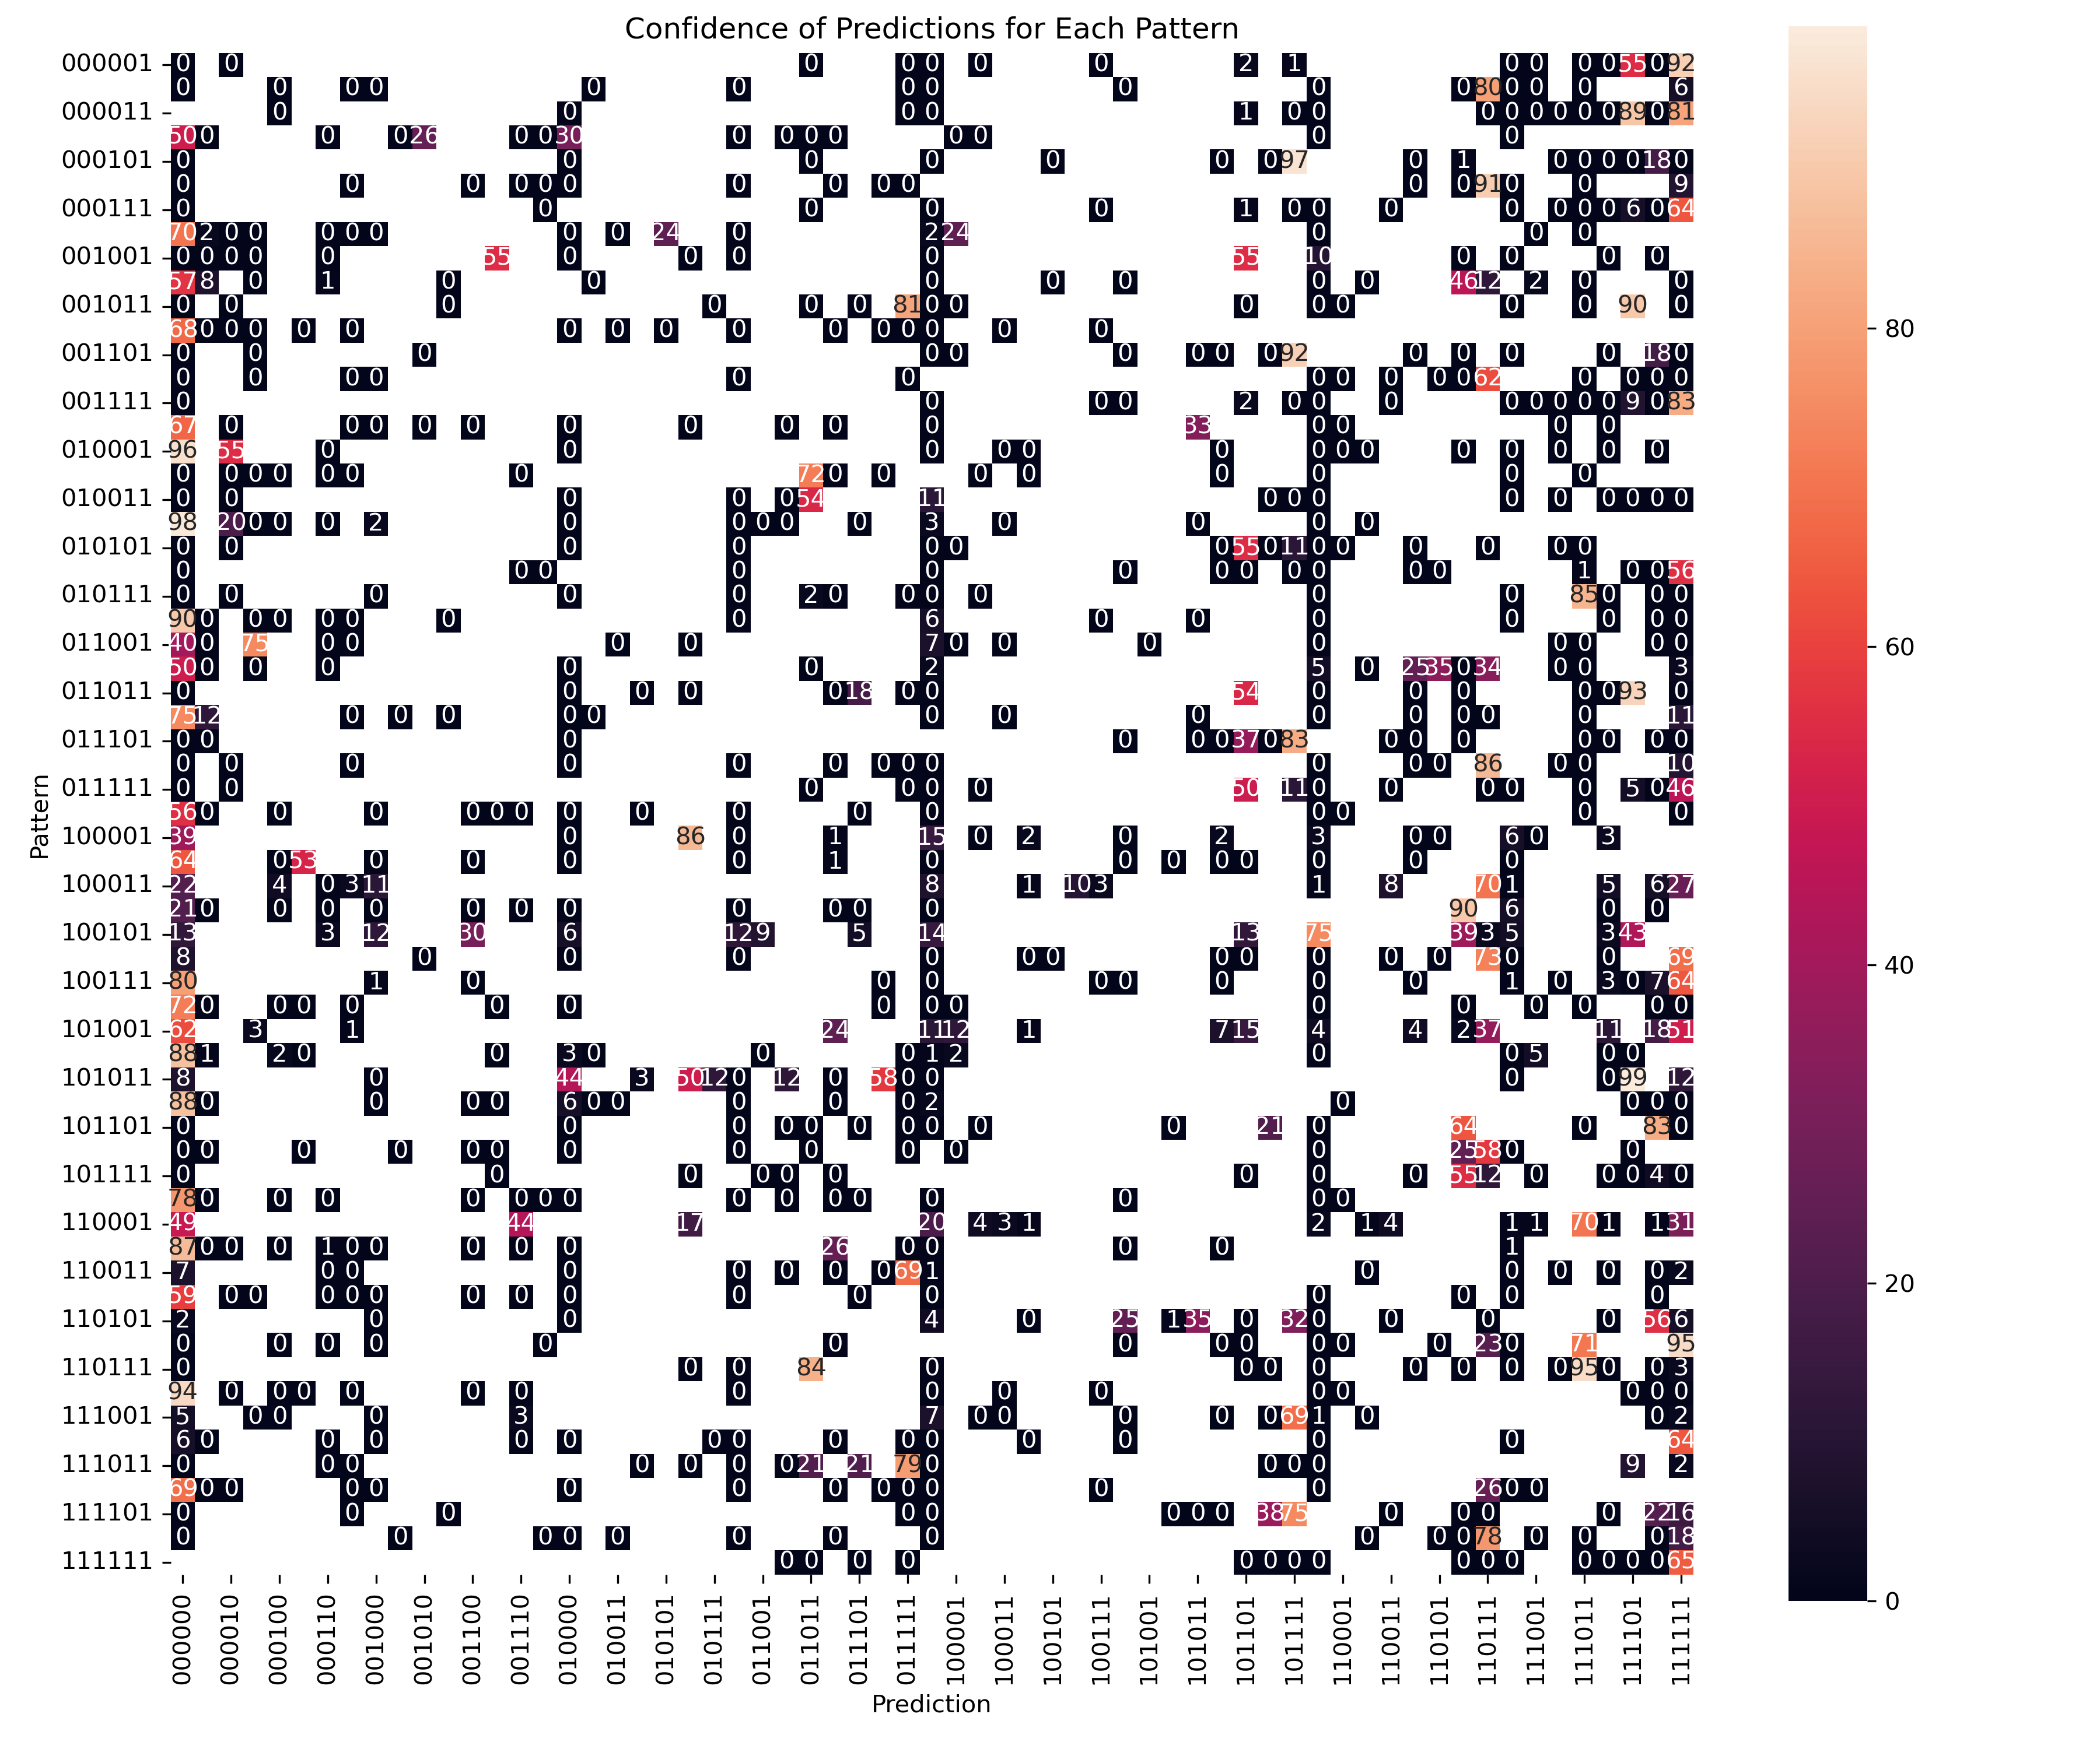
Design - Lookahead
Over time, SPPAM will compile a pattern table that encodes these patterns
This table is from SPEC2017’s 605.mcf workload
Notes:
Here is an example of a pattern table built when running 605.mcf_s-1554B. We notice that the graph is fairly dense towards the left and right sides, and somewhat sparser towards the middle. Note that there is a heavy bias towards 000000 – this is a result of the timely learning of patterns – when scraped at the appropriate time, these 0 predictions indicate the end of an access stream.

Slide 23
Design - Lookahead
010011
011011
Notes:
Lets assume a pattern begins traversal at 010011, SPPAM will look into the pattern table and grab the highest-confidence traversal candidate it can.
This yields 011011, and we can continue

Slide 24
Design - Lookahead
010011
111101
011011
Notes:
Now if we do a lookup on this piece, we get 111101

Slide 25
Design - Lookahead
010011
011011
111101
101111
Notes:
And another lookup yields 101111

Slide 26
Design - Lookahead
010011
011011
111101
101111
110110
4 table references
18 prefetch targets
Notes:
And this last reference yields 110110, and this is by no-means the end of this path, it continues on to 111111, at which point its going to enter an infinite regress of 111111, but SPPAM is unlikely to traverse beyond two or three table rereferences, unless the usefulness of these patterns are incredibly high.
And if we look at the final pattern you will notice that there is some order to this pattern. Despite no predictions repeating here, we are left with a nice symmetrical prediction. It’s likely this path if referencing some data structure, so this emergent behavior from these predictions is a good confirmation that SPPAM is learning a lot about how these regions are structured.

Slide 27


Design - Filtering
SPPAM incorporates usefulness feedback by sampling usefulness for each pattern
Each pattern’s usefulness determines whether it will be probabilistically dropped and whether it may attempt lookahead prefetching
The pattern that triggered each prefetch can be inferred from the region’s access map
If region entries don’t last long enough, SPPAM falls back to utilizing global usefulness
Notes:
SPPAM tracks usefulness both per pattern and globally. If region entries hang around long enough for its useful or useless prefetches to be determined, then we can utilize the region table to find the pattern(s) that originated the prefetch and decrease it’s usefulness. If the region table is thrashing – each entry has a short lifespan – we must default back to global usefulness which tells us the proportion of all prefetches that are useful or not.
Besides limiting the prefetch degree, usefulness below 50% also causes SPPAM to probabilistically drop prefetches – utilizing a cycle counter and comparator. We want to occasionally attempt prefetching again to allow SPPAM to regain confidence
- Not possible if no prefetches are allowed to be issued at all.

Slide 28
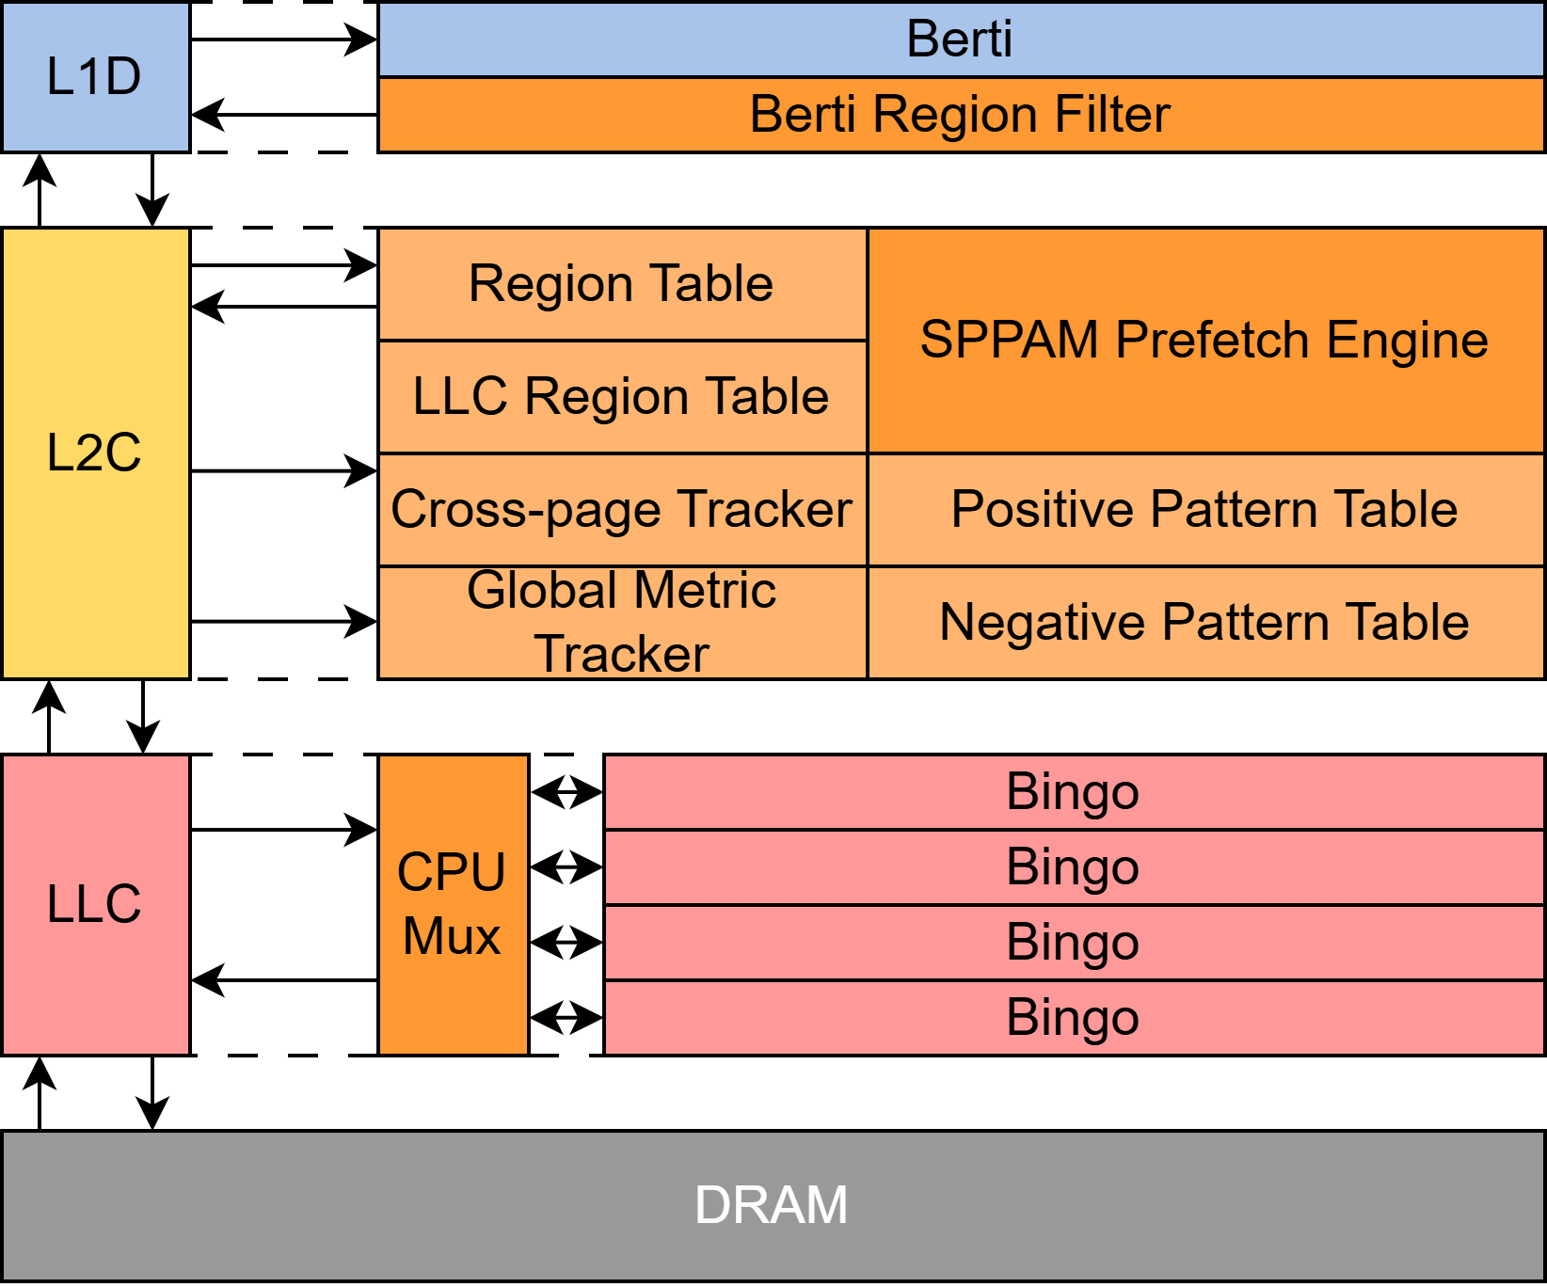
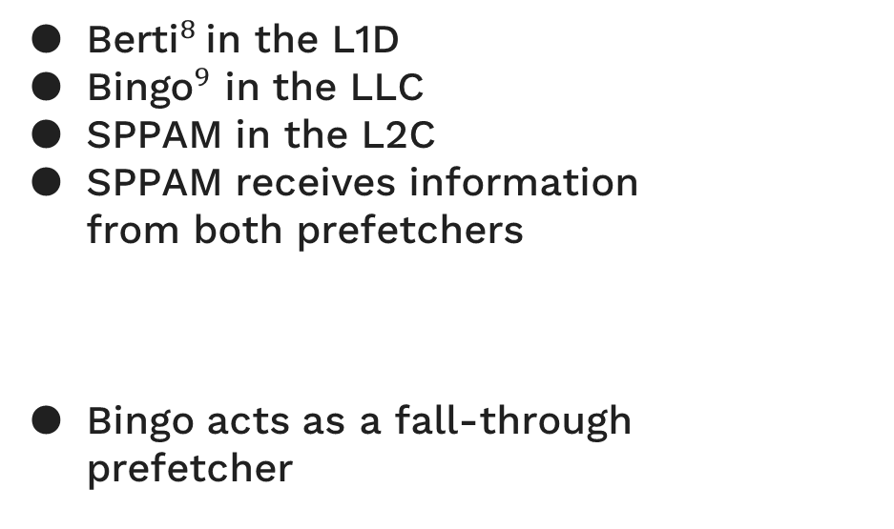
Design - Overview
${\text{Berti}}^{8}$in the L1D
${\text{Bingo}}^{9}$ in the LLC
SPPAM in the L2C
SPPAM receives information from both prefetchers
Bingo acts as a fall-through prefetcher
Page associations from Berti
LLC occupancy from Bingo
Berti trains SPPAM well
[8] Mohammad Bakhshalipour, Mehran Shakerinava, Pejman Lotfi-Kamran, and Hamid Sarbazi-Azad. 2019. Bingo Spatial Data Prefetcher. In 2019
IEEE Interna-tional Symposium on High Performance Computer Architecture (HPCA). 399–411.doi:10.1109/HPCA.2019.00053
[9] Agustín Navarro-Torres, Biswabandan Panda, Jesús Alastruey-Benedé, PabloIbáñez, Víctor Viñals-Yúfera, and Alberto Ros. 2022. Berti: an
Accurate Local-Delta Data Prefetcher. In 2022 55th IEEE/ACM Int. Symp. on Microarchitecture.IEEE Press, Chicago, IL, USA, 975–991.
doi:10.1109/MICRO56248.2022.00072
Notes:
For our final prefetcher configuration, Berti was used in the L1D, SPPAM in the L2C, and Bingo in the LLC. There was some metadata-based sharing between Berti and Bingo to SPPAM, so SPPAM had a rough idea of the sequence of physical pages as well as the occupancy of blocks in the LLC. Bingo is a prefetcher I haven’t mentioned as of yet, but it is quite useful in the sense of looking at many different properties of accesses when making prefetch decisions. Berti has a tendency to throttle itself on some workloads where prefetching offers massive benefits (607.cactuBSSN) and SPPAM is limited to spatial correlations. So, if demand streams are reaching the LLC then Bingo is going to learn what Berti and SPPAM cannot and provide a last-line-of-defense against unnecessary throttling behaviors.

Slide 29
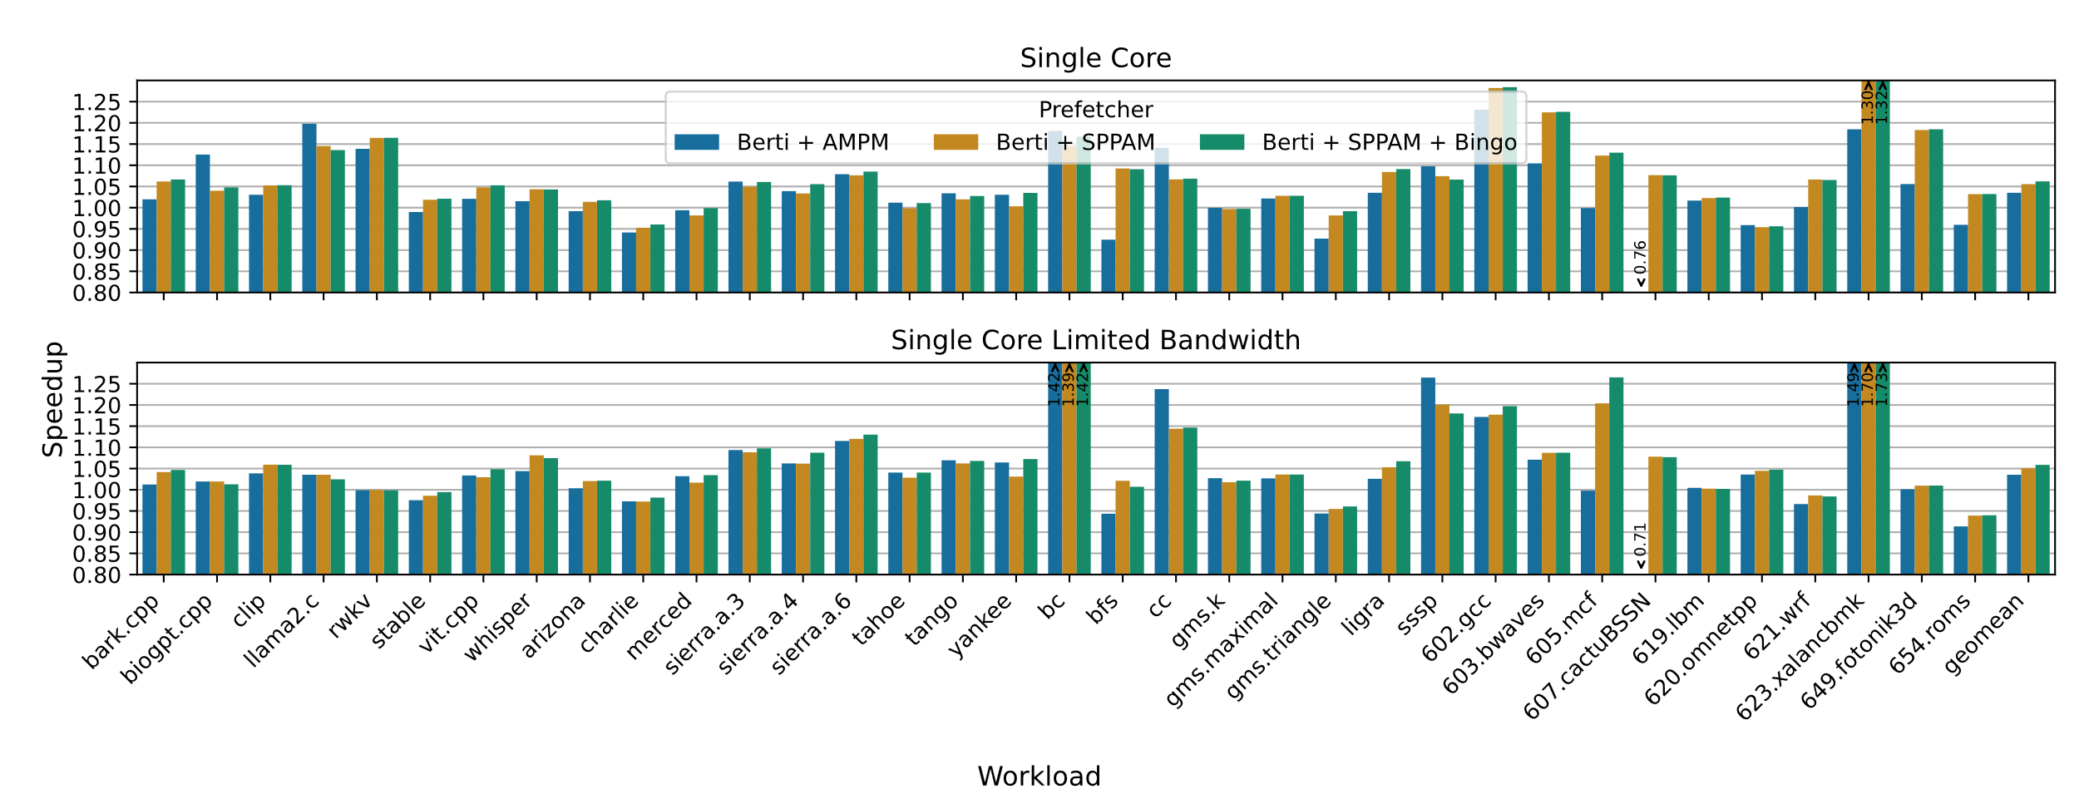
Evaluation – Single Core Speedup over Berti + Pythia – Geomean: 6.2, 5.9%
Notes:
We have plotted the performance of regular AMPM in blue, SPPAM in orange, and SPPAM with the inclusion of Bingo in the LLC in green.
We found the greatest improvements over the baseline occurred due to throttling rather than accuracy or coverage. BC, MCF, and XALANCBMK are all workloads where SPPAM decided to not prefetch.
I want to draw your attention to these circles here. These are cases where traditional AMPM beats SPPAM, and by a significant margin. What this suggest to use is that for some workloads SPPAM is either failing to learn these simple patterns or is behaving too aggressively.
These are also workloads where Berti + Pythia was slower than what we would expect, suggesting these may be linked. Perhaps AMPM’s conservative nature (at least in ChampSim’s implementation) is the reason here

Slide 30
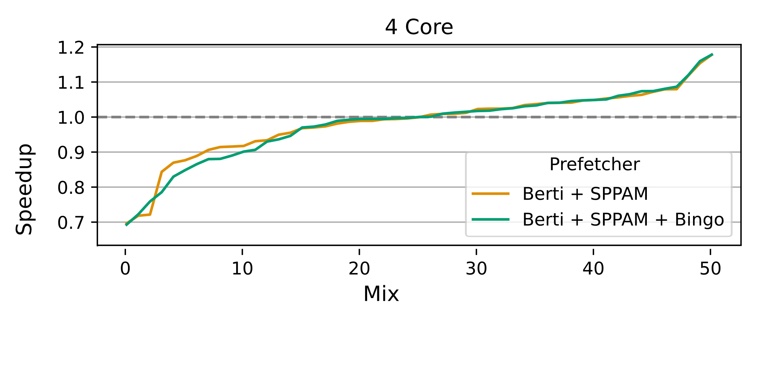
Evaluation – Multi Core Speedup over Berti + Pythia – Geomean: -2.12%
Notes:
For multi-core, we ran 50 random mixes of the provided traces. Here, we can see SPPAM has trouble achieving any speedup over the baseline. In fact, we saw a 2.12% slowdown compared to Berti + Pythia. SPPAM clearly outperforms AMPM, though is clearly not as good as Pythia.
I am confident that with additional tuning we could rectify these issues in multi-core. Note here that Bingo is providing no benefits – in fact, it hurts us in a few cases. I think this suggests that better throttling heuristics would be beneficial. From our data, SPPAM is turning itself off for a lot of these mixes – suggesting that either bandwidth utilization throttling is too aggressive, or increased latencies in the memory are impacting SPPAM’s learning.

Slide 31

Conclusion
SPPAM is still an unoptimized design in many ways
The general design trajectory of SPPAM seems to be leading somewhere interesting
Better heuristics for triggering learning, maybe SMS/${\text{Tempo}}^{10}$ can help us here?
What is the ideal pattern length?
Are there better ways to throttle SPPAM?
AMPM, SPP, and SPPAM all have interesting parallels with branch prediction (PPM)
Can we leverage what has been learned in that field for future prefetcher designs?
DRAM-aware?
[10] M. Sutherland, A. Kannan, and N. Enright Jerger, ‘Not Quite My Tempo: Matching Prefetches to
Memory Access Times’, 06 2015.
Notes:
SPPAM still needs work, but I am more interested in the design trajectory SPPAM took compared to AMPM and SPP. You might have heard me mention history multiple times throughout this presentation. Branch prediction deals a lot with making single bit predictions from histories and other information. I believe that there are many improvements that can be made to SPPAM by taking in those ideas – not only is there a lot of work on these strategies but we know how to build them.
It is enticing to believe that branch prediction designs could be made into prefetchers with the right techniques.

Slide 32
Q/A
Notes:
SPPAM still needs work, but I am more interested in the design trajectory SPPAM took compared to AMPM and SPP. You might have heard me mention history multiple times throughout this presentation. Branch prediction deals a lot with making single bit predictions from histories and other information. I believe that there are many improvements that can be made to SPPAM by taking in those ideas – not only is there a lot of work on these strategies but we know how to build them.
It is enticing to believe that branch prediction designs could be made into prefetchers with the right techniques.

Slide 33
Background - Comparison
Both SPP and AMPM try to recognize history within regions
SPP builds its pattern table, while AMPM utilizes a pre-built catalogue
Each can issue multiple prefetches
SPP keeps a detailed short-term history
AMPM keeps a vague long-term history
[2,-1,3]
1001001001
SPP can perform lookahead
AMPM’s pattern catalogue can provide multiple targets
Notes:
Both SPP and AMPM are recording region history. SPP goes for a short, detailed history while AMPM keeps a bitmap for the entire region which allows it a much longer history – though we lose some detail such as ordering.
AMPM gets to utilize it’s pre-built catalogue, while SPP builds it’s own from scratch.
And each have similar capabilities in terms of speculation – though SPP can go far deeper than AMPM, since it’s lookahead method incurs no storage overheads unlike AMPM.

Slide 34


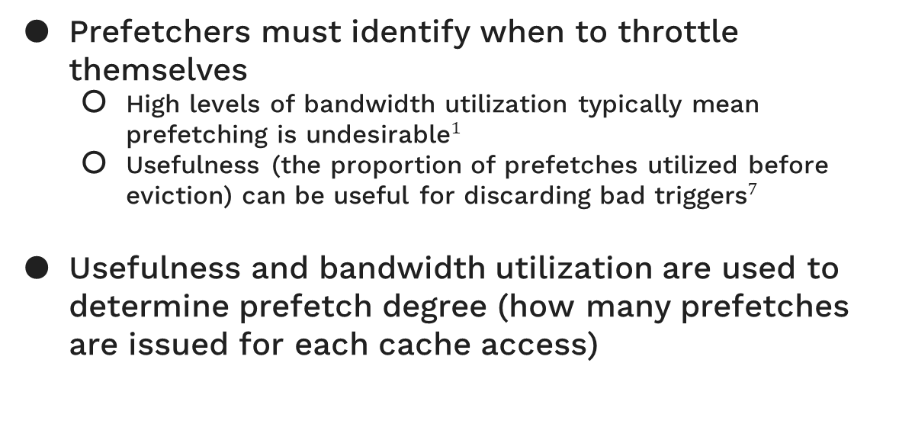
Design - Filtering
Prefetchers must identify when to throttle themselves
High levels of bandwidth utilization typically mean prefetching is ${\text{undesirable}}^{1}$
Usefulness (the proportion of prefetches utilized before eviction) can be useful for discarding bad ${\text{triggers}}^{7}$
Usefulness and bandwidth utilization are used to determine prefetch degree (how many prefetches are issued for each cache access)
[7] Viji Srinivasan, E.S. Davidson, and G.S. Tyson. 2004. A prefetch taxonomy. IEEETrans. Comput. 53, 2 (2004), 126–140.
doi:10.1109/TC.2004.1261824
[1] Lei Wang, Chia-Hang Lee, Maccoy Merrell, Gino Chacon, Daniel A. Jiménez, andPaul V. Gratz. 2025. R-Max: A Method for
Approximating the Benefit of Ideal Prefetching and Replacement Policy. IEEE Computer Architecture Letters 24, 2(2025),
293–296. doi:10.1109/LCA.2025.3611316
Notes:
Besides prefetching correctly – there are also the issues of available bandwidth and overall usefulness. Bandwidth availability can estimate the overall cost of prefetching – good or bad – on the latency of other accesses.
Usefulness isn’t necessarily correctness – usefulness can be low due to cache thrashing or incorrectness, both of which should and can be avoided through self-throttling..
SPPAM changes it’s prefetch degree according to both usefulness and bandwidth utilization, ensuring that it avoids prefetching in situations where it performs poorly.

Slide 35
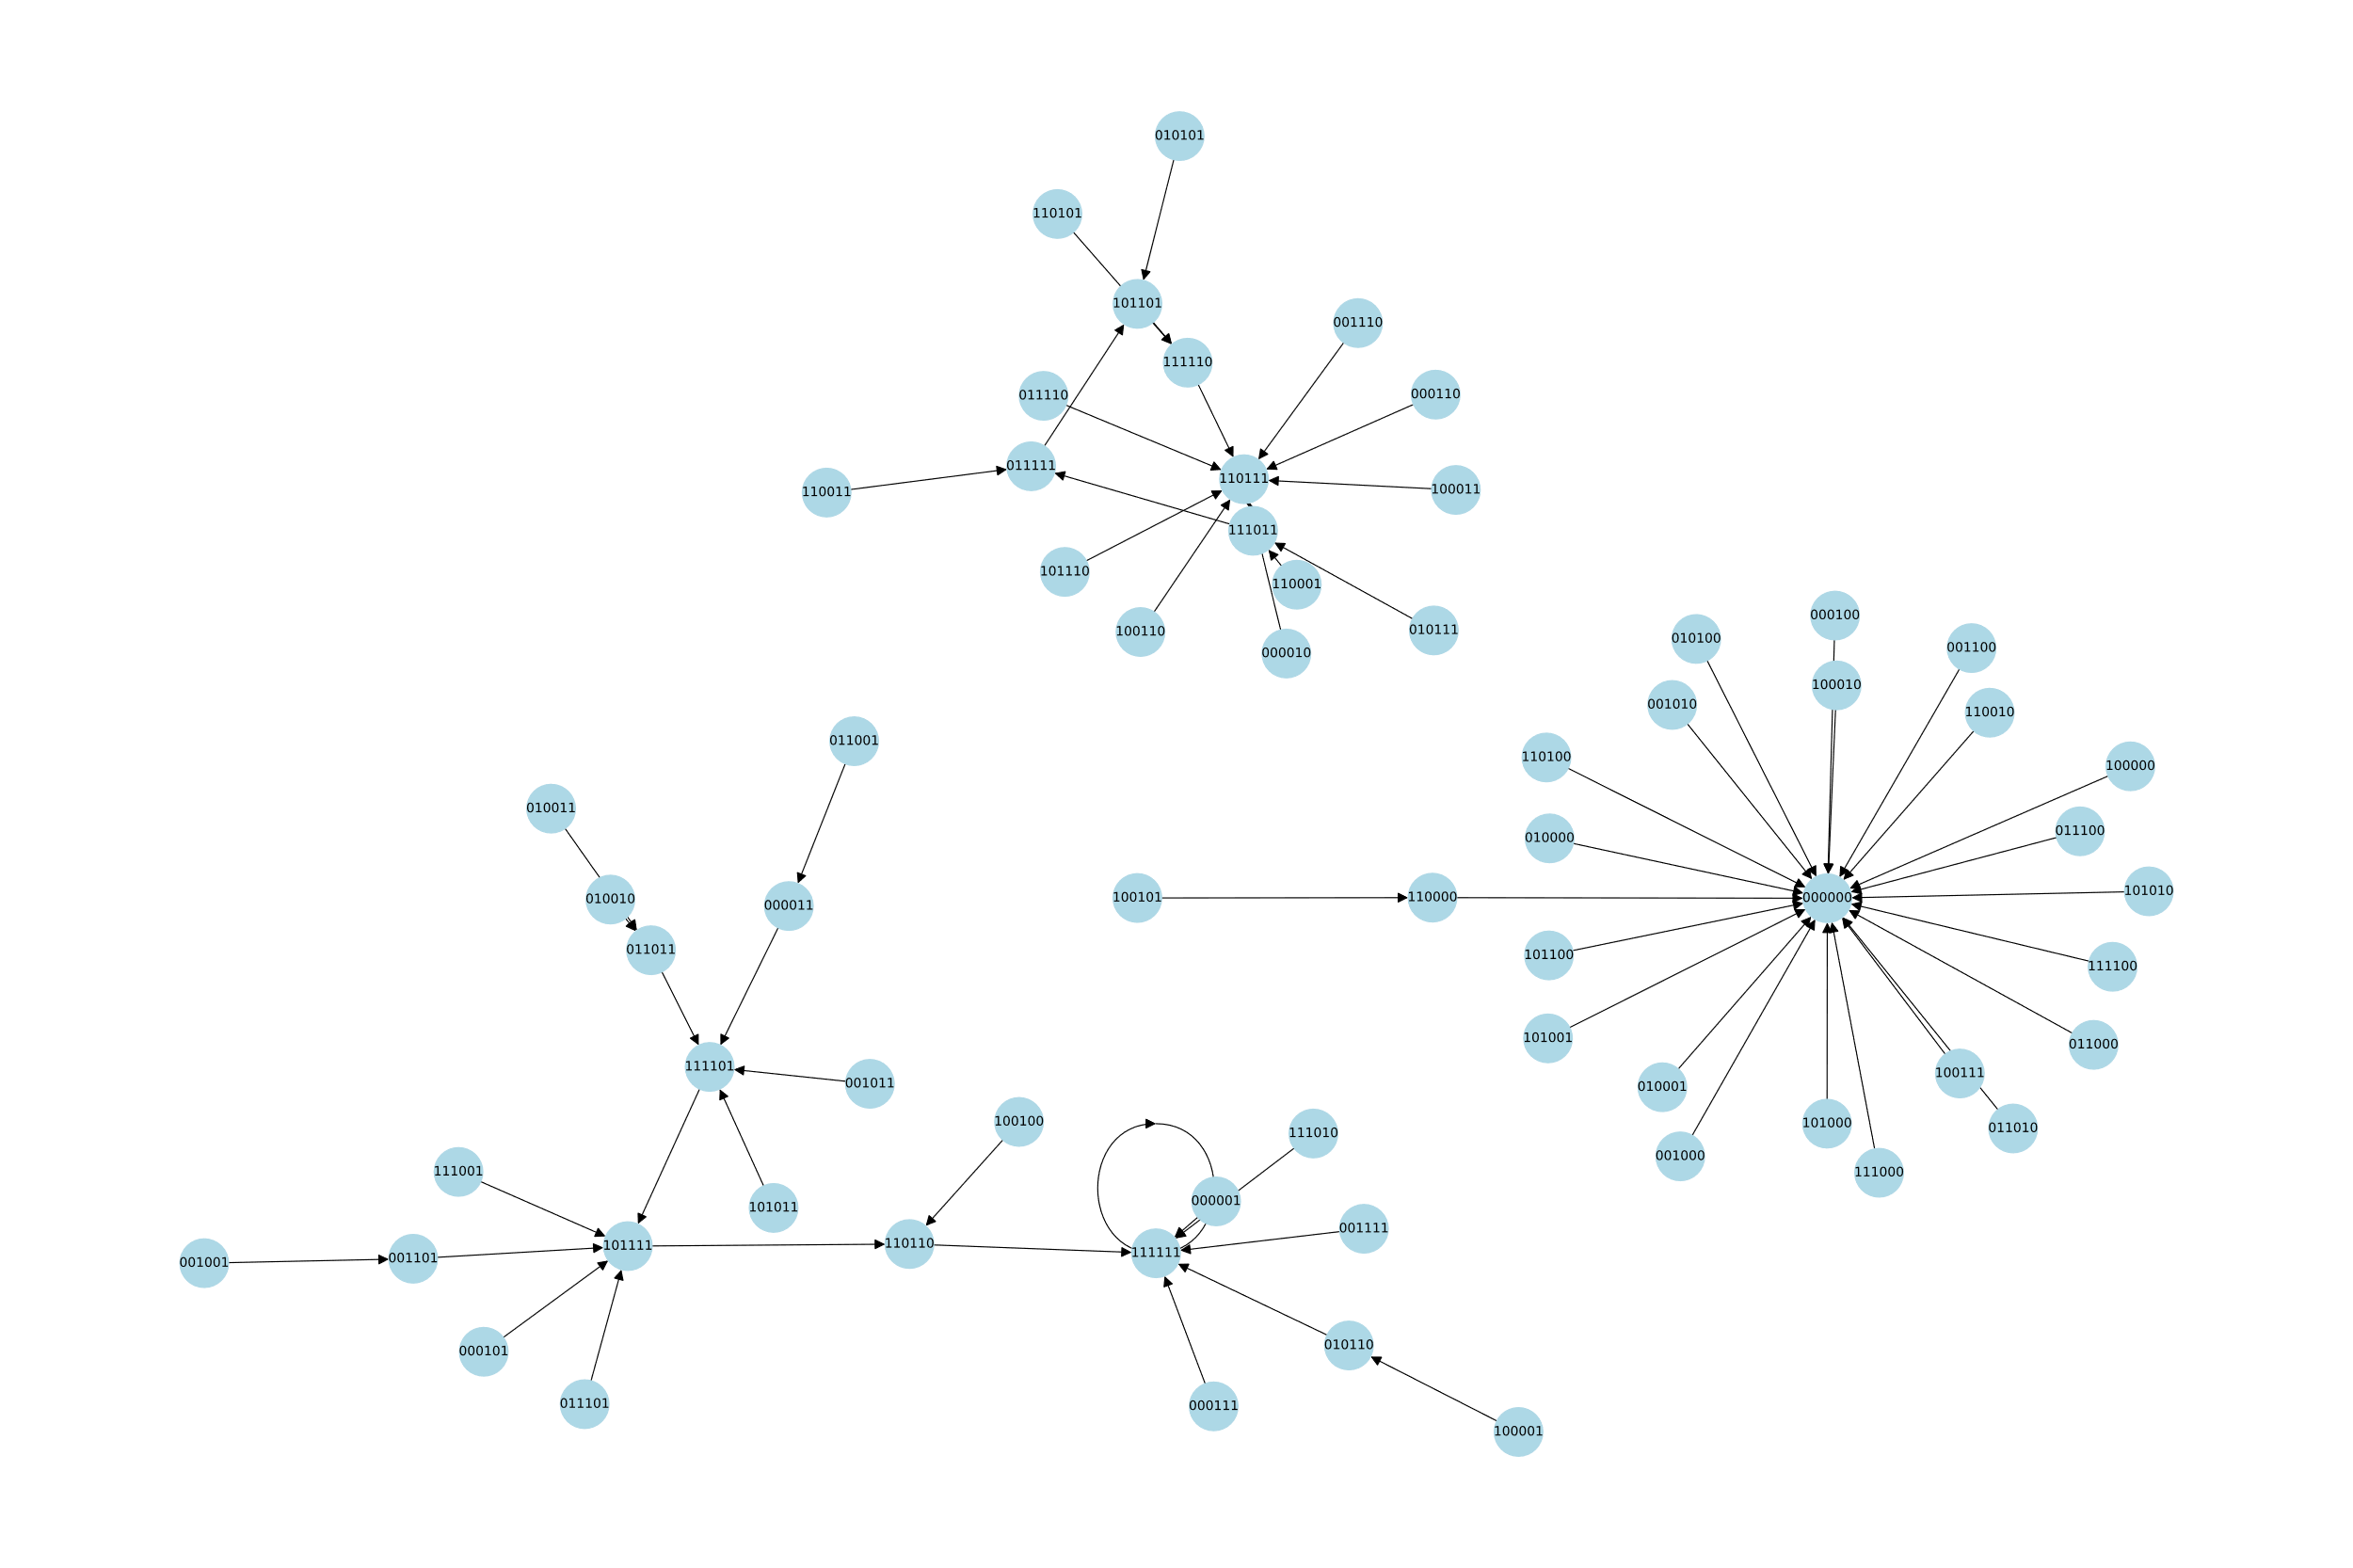
Design
SPPAM learns the access behaviors and forms graphs to prefetch into regions
These are based on the encoded Markov chain
Notes:
If we go ahead and plot all the paths encoded in the pattern table for this workload, we get a graph like this with three distinct groups. This is a broad trend we see across nearly all the workloads, where we have two end points at 111111 and 000000, and then some number of other groups that tend to follow a similar converging behavior. This bottom-left graph is the one we were just traversing, but you can see that many patterns lead to 000000 which is effectively the terminating set. If any of these patterns appear, it assumes the traversal is dead and it’s effectively killed. On the other hand, we have this upper graph that forms a loop from 110111, 111011, 011111, 101101, 111110 and back to 110111. If you do that full-traversal, you will realize that loop is playing that same pattern we just predicted, but from different entry points. Unlike our traversal entry point though, that pattern never ends while our entry point tells SPPAM that we will eventually converge to a 111111 loop instead.

Slide 36
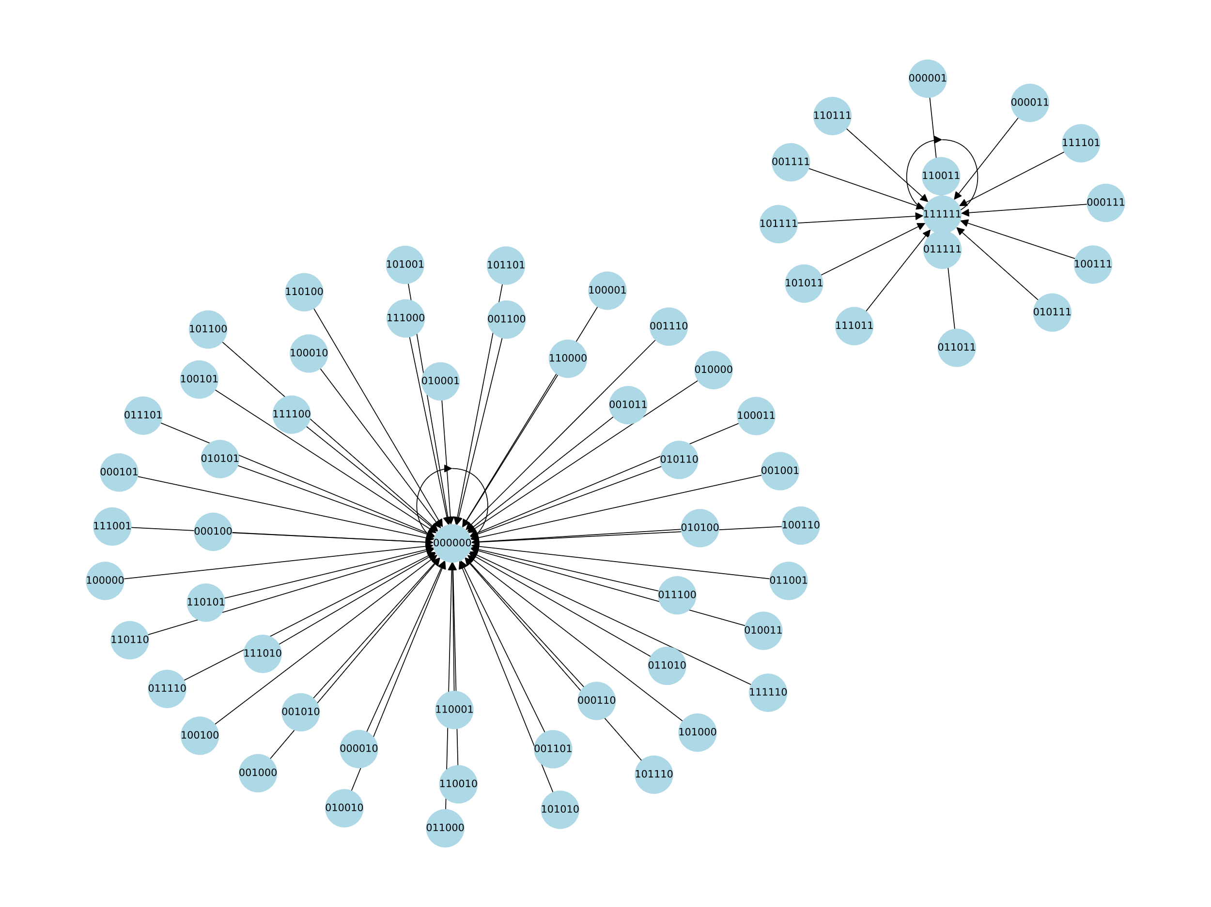
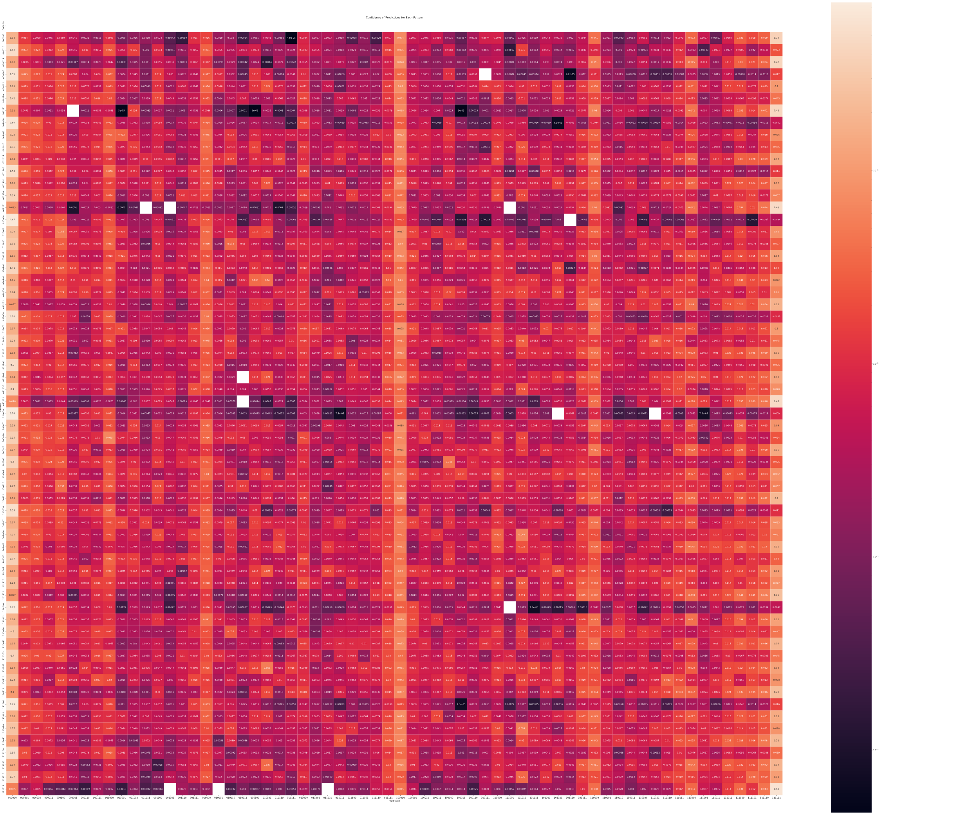
Design – Learning
Why no offline learning?
A naïve approach leads to this resulting graph
Notes:
SPPAM still needs work, but I am more interested in the design trajectory SPPAM took compared to AMPM and SPP. You might have heard me mention history multiple times throughout this presentation. Branch prediction deals a lot with making single bit predictions from histories and other information. I believe that there are many improvements that can be made to SPPAM by taking in those ideas – not only is there a lot of work on these strategies but we know how to build them.
It is enticing to believe that branch prediction designs could be made into prefetchers with the right techniques.

Slide 37
Design – Learning
Why predict more than 1 bit? SPP and branch prediction get by with a single target prediction!
Costly to reference the table per-spatial prediction
A multi-bit prediction of all 0’s gives us a useful terminator symbol
Usefulness/Uselessness data is easier to correlate with multi-bit predictions
Notes:
SPPAM still needs work, but I am more interested in the design trajectory SPPAM took compared to AMPM and SPP. You might have heard me mention history multiple times throughout this presentation. Branch prediction deals a lot with making single bit predictions from histories and other information. I believe that there are many improvements that can be made to SPPAM by taking in those ideas – not only is there a lot of work on these strategies but we know how to build them.
It is enticing to believe that branch prediction designs could be made into prefetchers with the right techniques.

